Slide 1
Scouting Adventures
Bahamas Live Aboard Diving & Snorkeling Cruises

Slide 2
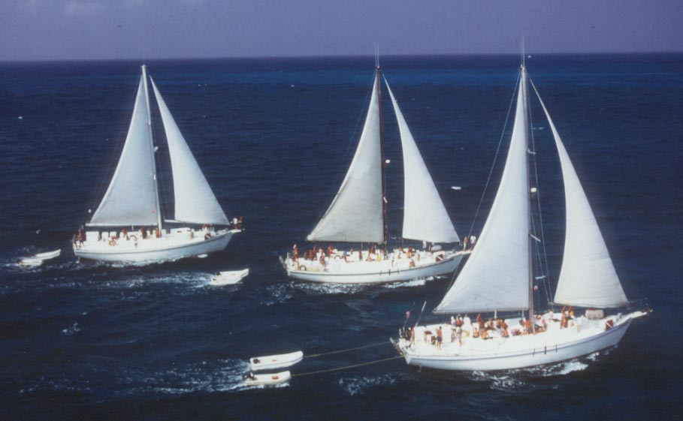
30 Years of Scuba Diving
A little history….
Blackbeard’s Cruises was founded in 1979 by Bruce Purdy…a scouting parent who’s first trips were for Sea Base.

Slide 3
Dive/snorkel & Sail the Western Bahamas
Notes:
Cruises depart from Freeport Grand Bahama and explore the Western Bahamas. Mid week port night is usually spent in Bimini on South Bimini island.

Slide 4
Adventures on the High Seas
Scouts enjoy the crystal clear waters of the Bahamas, both above and below the waterline! Surface intervals between dives are spent sailing, swimming, snorkeling, fishing ….

Slide 5
The Adventure Begins Before the Journey
For many youths, international travel is a new experience! Passports, planning, prepping for the trip…all of the pre-trip buildup increases the excitement about their upcoming scuba diving adventure!

Slide 6
Scuba Diving
Scouts can earn their Scuba badge prior to sailing or they can complete the process once on board.

Slide 7
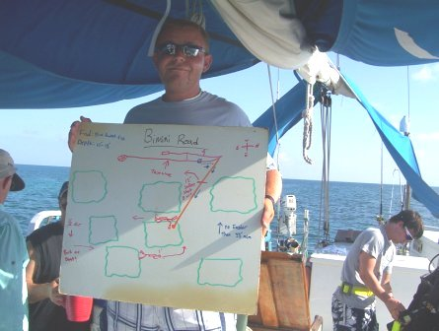
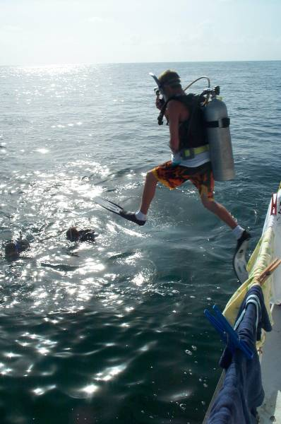
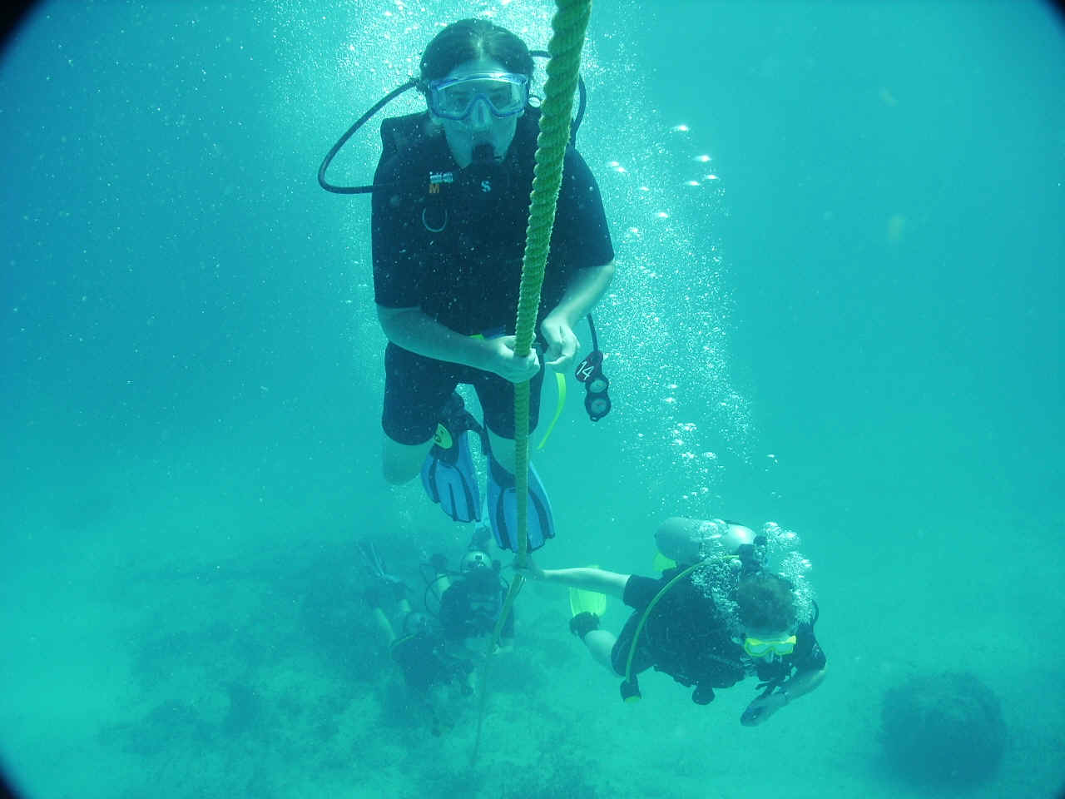
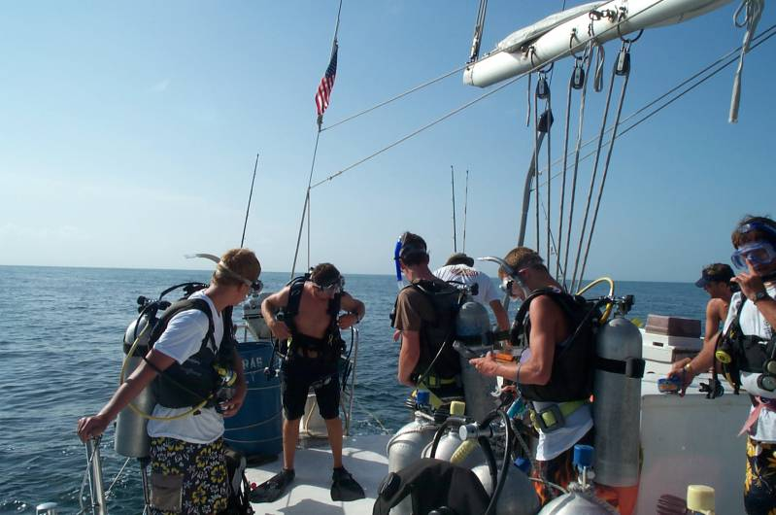
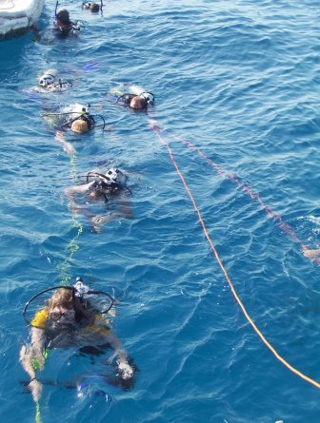
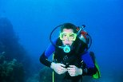
Our Dive Instructor briefs each dive site thoroughly offering tips on navigation, planning profiles and
points out marine life specific to
the site for the divers
to find and identify.
Dive Briefing
Entry
Gearing Up
Safety Stops
Lots to See
Back to the Boat
Notes:
Dive instructors use white boards to provide VISUALS for each dive briefing as well as first hand knowledge and antidotes. Safety is always FIRST.
Photos: Dive instructor briefing board, gearing up, giant stride into the water, scout diving, returning to the mooring line for a safety stop, back to the boat on the tag lines.

Slide 8
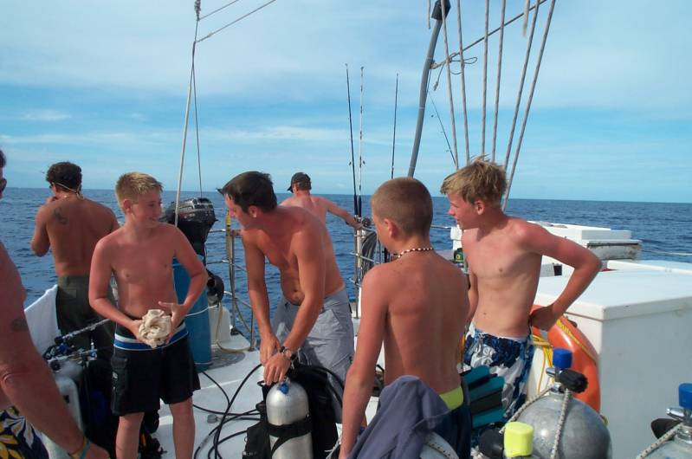
Post Dive Enthusiasm Is Highly Contagious!
Divers share stories and sightings
with the crew and each other.
Notes:
This is the best part! Watching the scouts share their new found joy and wonder of the underwater world with each other is truly

Slide 9
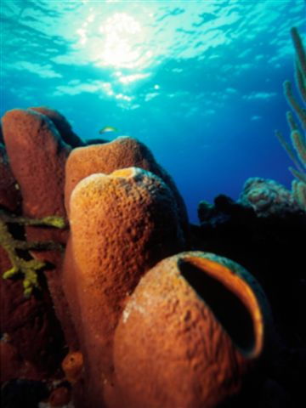
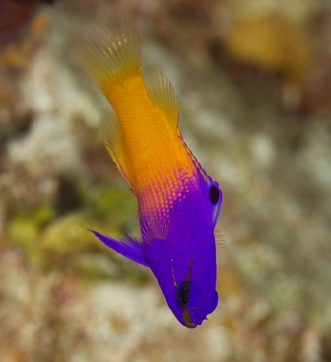
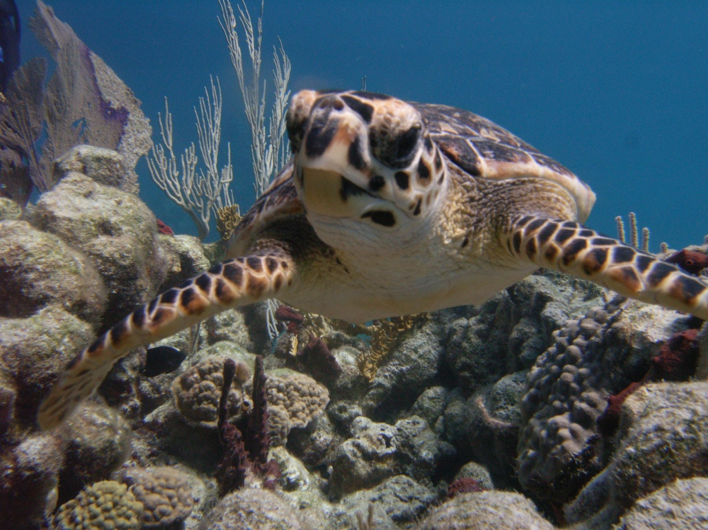
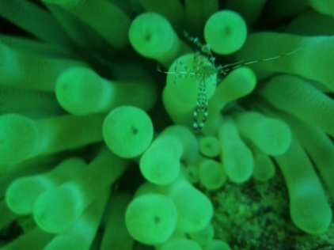
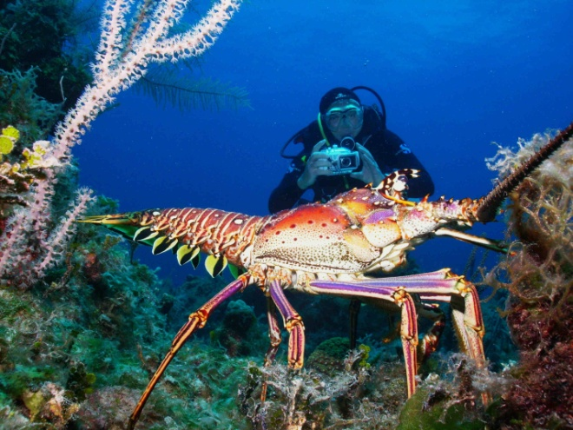
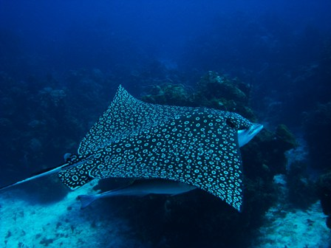
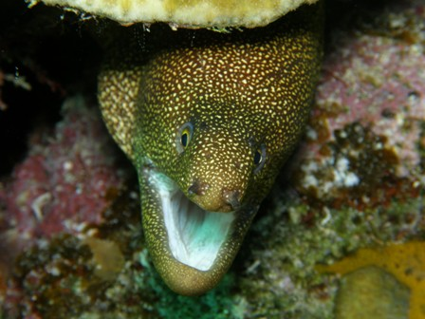
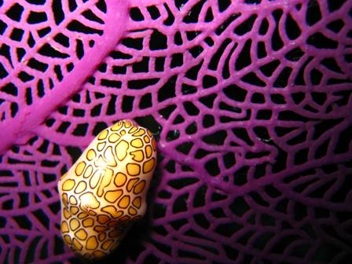
Notes:
The marine life is diverse in the Bahamas with big critters and large quantities of fish! Look closely, the small stuff can be the most fascinating….discoveries on each dive are shared topside and add to the total experience. We encourage our divers to complete REEF fish surveys to aid researchers around the world. REEF packets can be purchased prior to boarding so that scouts are ready to begin!

Slide 10
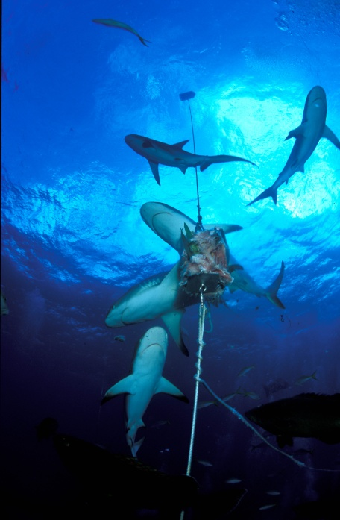
Shark Feed Dive at Bull Run
Shark behaviors are observed during our thrilling shark feed dive!
This dive is optional and at no additional cost.
The shark bait “chum”-sickle is made up of the fish caught during the week not fit for human consumption.

Slide 11
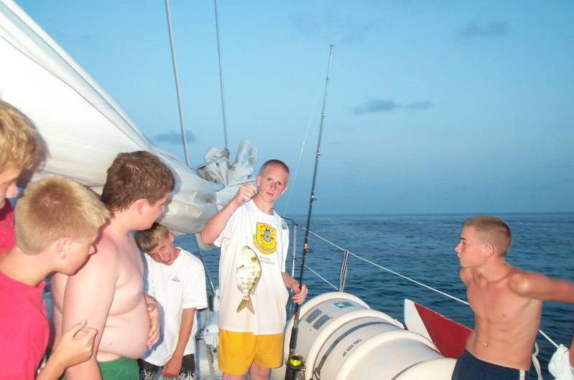
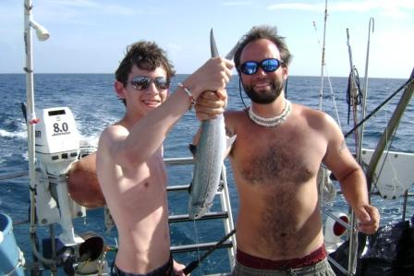
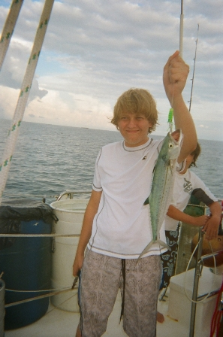
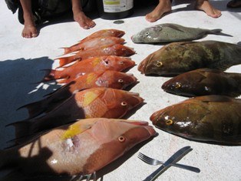
First you Fish…
Notes:
Blackbeard’s provides all the fishing gear on board. We also provide the slings for spear fishing and will provide instruction on the proper way to hunt fish and lobster according to Bahamian Law.

Slide 12
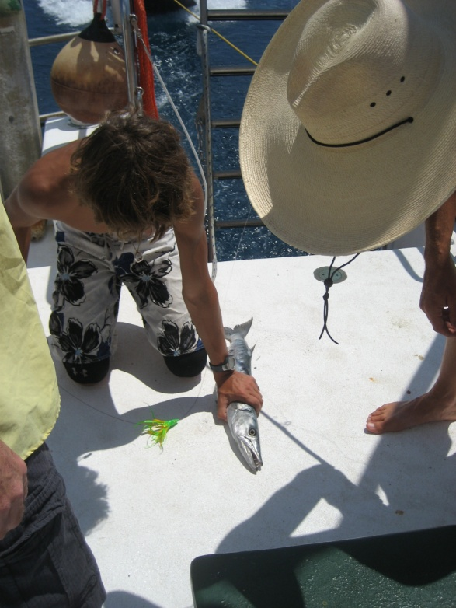
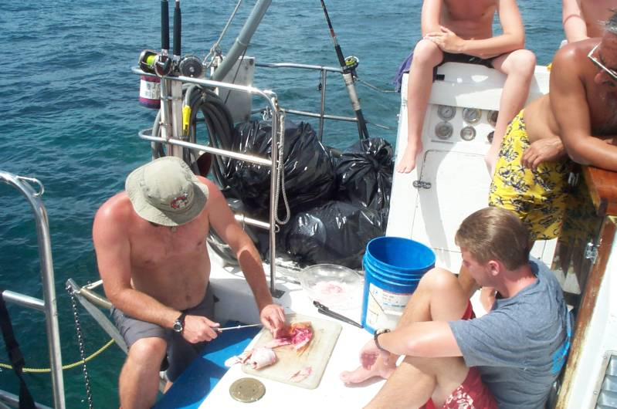
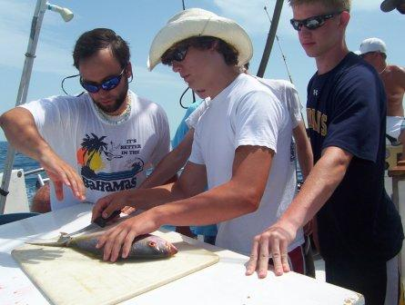
Then you clean!
Notes:
Scouts learn to clean fish, conch and lobster that is caught on board. Any fish not edible by humans is saved for the shark dive. (The shark dive is optional and at no additional cost. )

Slide 13
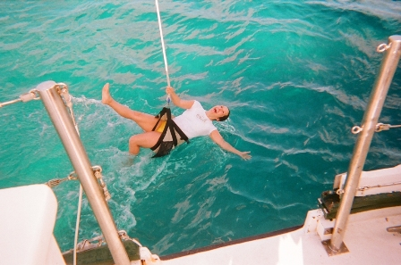
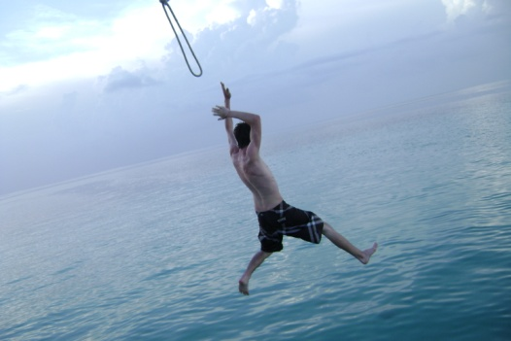
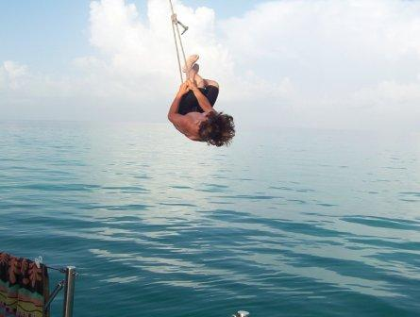
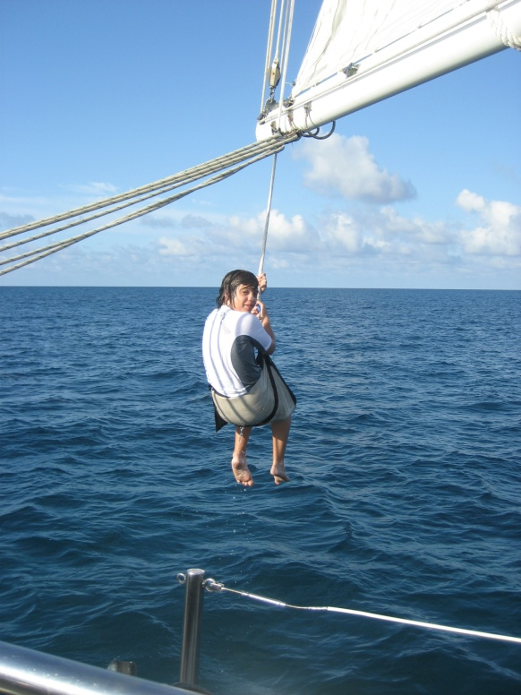
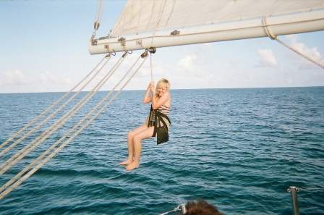
Halyard Swing
Notes:
Scouts enjoy a bouncing, dipping ride on the halyard swing- the boom swing is very popular for surface interval fun!

Slide 14
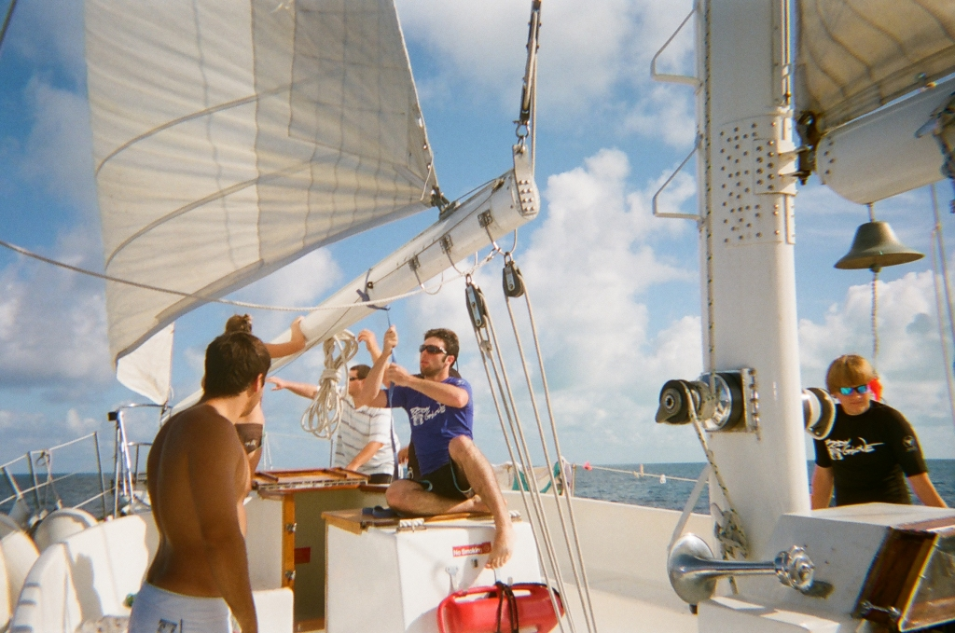
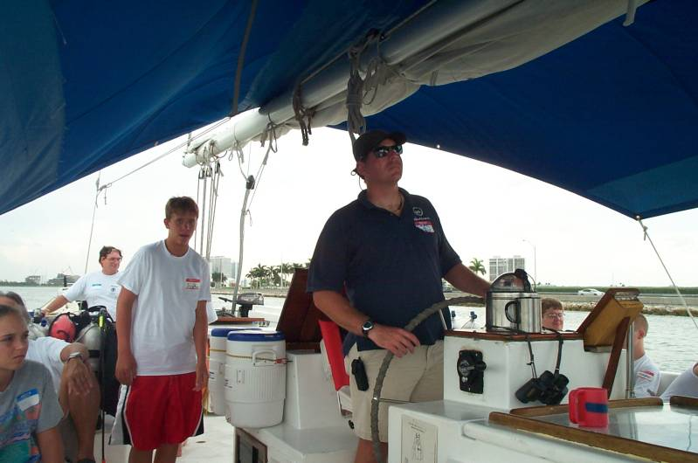
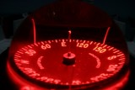
Sailing
Notes:
Sailing opportunities are offered when the winds permit. Navigation, knot tying, mooring and anchor-ology are all learned during the course of the week.

Slide 15
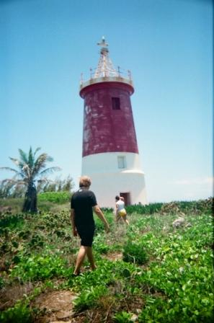
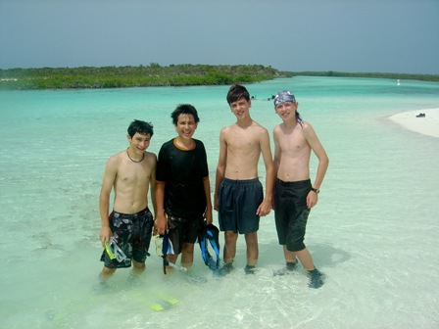
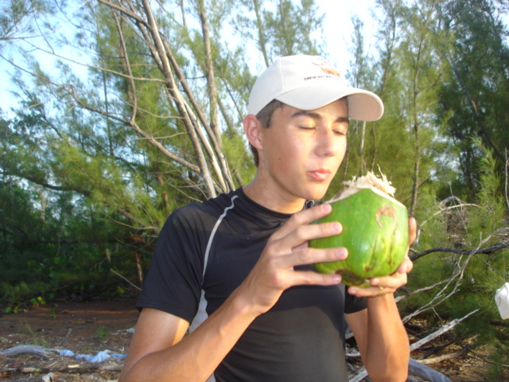
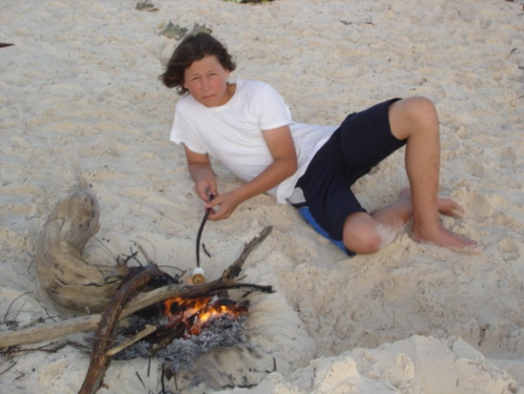
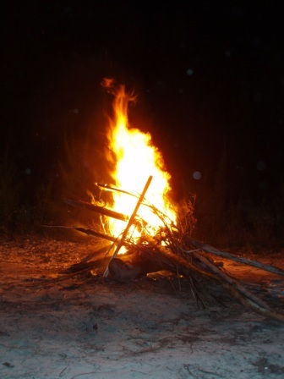
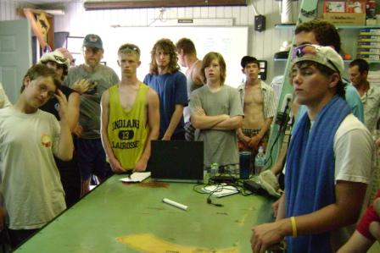
Shore Based Activities
Shark Lab
Bonfires
Nature Trails
Historic Landmarks
Much, much more!

Slide 16
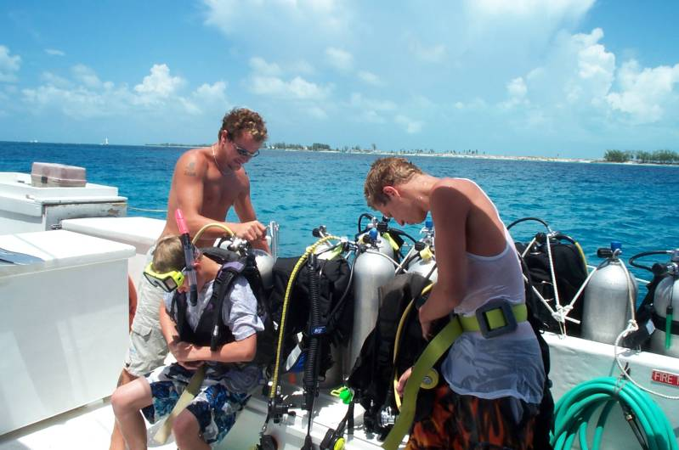
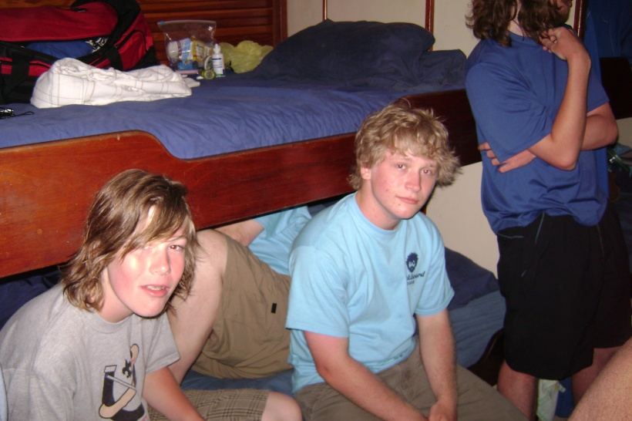
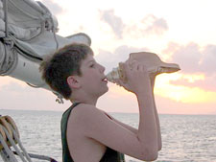
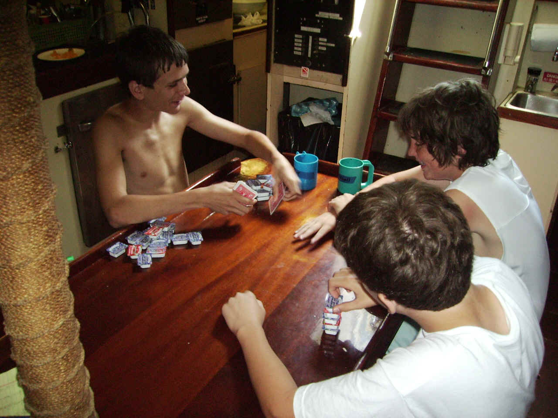
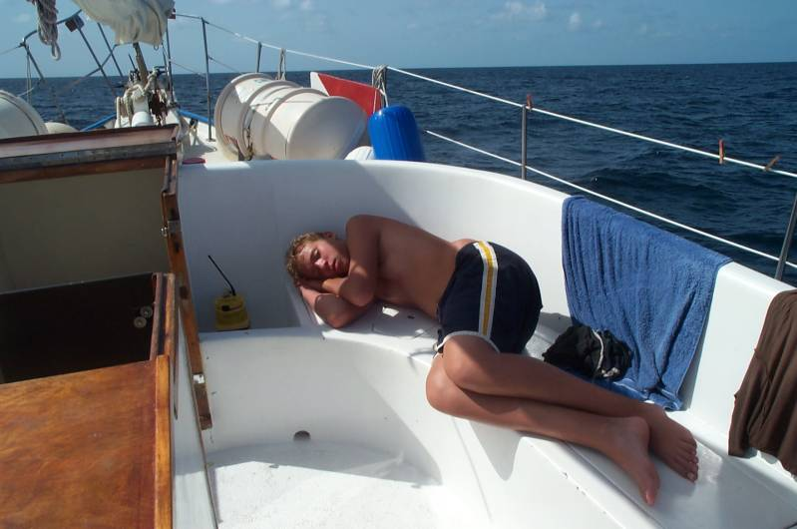
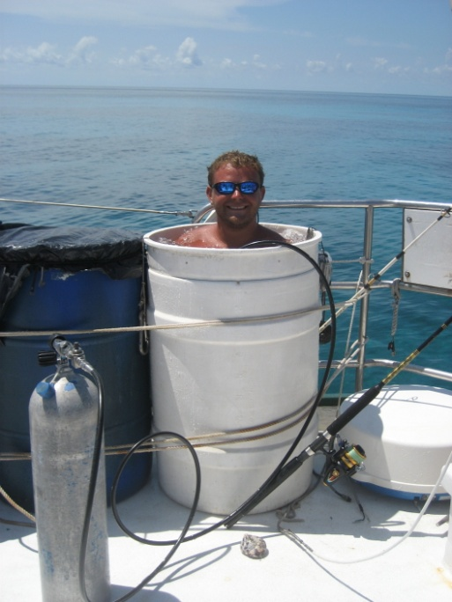
Life On Board
Notes:
Accommodations are slim on a sailboat, but scouts are used to it from all their experiences with camping. 3 Dormitory style cabins with 18 bunks on board total.
Main salon is home to the galley, showers, and is the main hub for hanging out. The horseshoe shaped seating area topside doubles as storage. One scout was creative and made a Jacuzzi out of the dunk tank using a spare air tank! Scouts practice blowing the conch to call everyone to the dinner table.

Slide 17
Accommodations
3 dormitory style cabins
18 bunks in upper & lowers
3 heads/bathrooms
1 shower
Notes:
Each cabin has its own sink, vanity and head. Scouts are required to keep their own bathrooms and cabins cleaned with a schedule provided by the crew.
Each cabin sleeps from 6-8 passengers. There are 9 sets of bunk beds on board for a total of 18 bunks on board. You may house more than 18 but must have couples sharing double bunks to make this possible.

Slide 18
Special Scout Pricing
$845 per person
plus taxes/fees
This includes:
Food- 3 meals per day plus snacks
Beverages- coffee, tea and OJ for breakfast, Punch & water the rest of the day. No soda, no Alcohol.
Accommodations
All diving including tanks, weights & weight belts
Crew gratuity

Slide 19
Not included:
Dive or snorkel gear – Rental Gear Available
Port tax - $35
Park fee - $10
Fuel surcharge - $40
Transportation to the boat
Scuba Certification

Slide 20
Finances
To guarantee the vessel for your troop exclusively, you must commit to pay for 18 passengers. (There are 18 berths on board). If you have less participants, we have the right to put other scouts on your boat. To keep the cost of the trip low, all payments must be made by check. There will be a 3% fee for any payments made by credit card.
Upon booking $500.00
December 15th $1,000.00
4 months prior $1,500.00
2 months prior Balance in Full
Refund Policy
There is no refund for cancellations after December 15th unless space is filled, in which case there will be a full refund. We will waive this penalty if you communicate with us and allow us time to book other scouts into your unfilled space

Slide 21
Licensed and Insured to Carry 24 Passengers
Meets International Maritime SOLAS Safety Standards
6 watertight compartments 2 life rafts on each vessel Trauma kit First aid kit Backboard Long distance radios EPIRB- Emergency Position Indicating Radio Beacon Rescue boat 4 life rings and 30 life jackets with lights 3 handheld waterproof emergency VHF radios for life rafts 2 Transponders Flares 4 ring buoys 2 O2 bottles including an H bottle Defibrillator Bilge and smoke alarms in all compartments 2 independent bilge pumps 7 fire extinguishers plus a fire pump Halon fire extinguishing system for engine & generators Communications & Electronics: SSB long range radio 2 VHF radios Radar 2 GPS Depth Finder Navtex weather system
SAFETY

Slide 22
Scout Referrals
"Crew was great! Food was great! Diving accommodations were excellent. We had a great crew all around; their interaction with our Scouts made a good trip a GREAT trip. The crew did fun activities with our Scouts and adults beyond the diving that made it a truly great experience."
Lee Clark; TLCLARK88@COMCAST.net BSA Troop 1919, Woodbridge VA
“One of the best diving experiences I have ever had, crew was fantastic, and the ship's cook deserves five stars. There were so many great (and favorite) memories created and this is a trip I plan to revisit in the future, and bring many new Boy Scout divers onboard with. It is nearly impossible to get a live a board at Sea Base today and you have the best alternative to that opportunity." James Chaplin; JHCHAPLIN@COMCAST.NET BSA Troop 1833, Haymarket VA.
"The crew was terrific. The Boy Scouts and the parents accompanying them had a fantastic time. A very safe and friendly environment with great crew, comfortable boat, super dives and snorkels and we even caught some fish!” Bill Topping; TOPPINGBILL@HOTMAIL.COM BSA Troop 888, Stuart FL
“If you ever need a recommendation for another troop considering sailing with you, please have them contact me. All our scouts & dads from BSA troop 461 would like to thank you for your assistance and hard work in arranging our trip.” Doug Raff; DRAFF55975@AOL.com BSA Troop 461, Inverness, IL

Slide 23
…Committed to the growth & development of our youth and dedicated to marine awareness through Scuba Diving.

Slide 24
For brochures and group booking information please contact our US Reservations Office
800.327.9600
www.blackbeard-cruises.com/scouts

